Slide 1
Stateful Prompt Orchestration for Complex Conversational Interactions
https://github.com/zhaw-iwi/promise

Slide 2
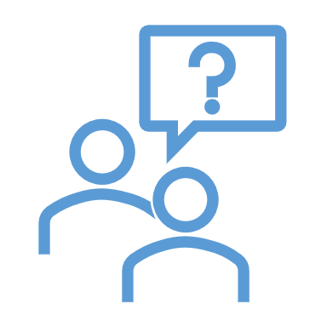
Leveraging Language Models for Advanced Conversational Interactions Our Contributions
Population
Problem
Lack of Solutions
Requirements
Challenges
Solution Design
Goal
e.g. improve therapy outcomes
Objective
e.g. improve literacy and adherence
Impact
e.g. enhanced literacy and adherence
Intervention
Evidence
Measurement
Experiment
Means
Feasibility
Value

Slide 3
Example Objectives
Improving treatment adherence in between consultations
Increasing health literacy of young adults with hearing loss
Overcoming administrative burdens in public services
Detecting Bloom's learning levels to personalise learning support
Detecting applicable construction laws to infer location-specific regulations
Investigations of feasibility and value of multimodal interactions

Slide 4
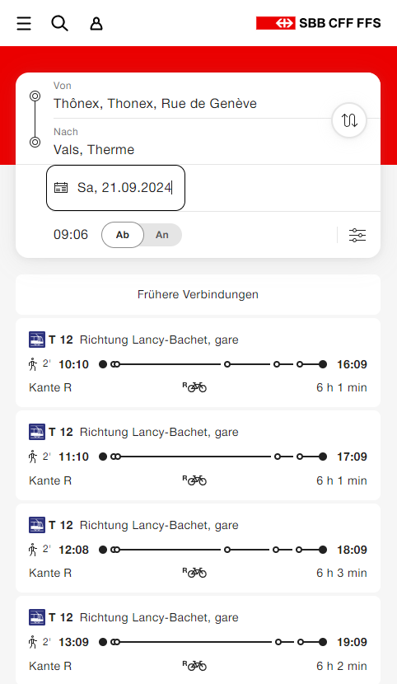
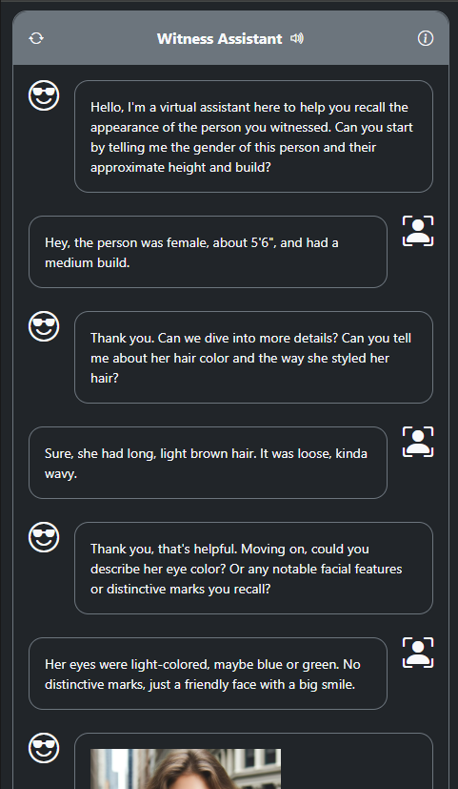

Je pense, donc je suisse
https://www.dell.com/en-us/perspectives/how-human-like-avatars-animate-online-experiences

Slide 5
E.g. ending an interaction
How to end an interaction based on conditions within a conversation section?

Slide 6
E.g. transition an Interaction
How to modify conversational behavior following a transition?

Slide 7
State of the Art
Dialogflow, Watson
Training from Scratch
Fine-tuning
Prompt Engineering
LangChain
Dialog Management
Dialogflow, Watson
Training from Scratch
Fine-tuning
Prompt Engineering
LangChain
Dialog Management

Slide 8
Needs
Design and implementation of complex interactions with LMs
Reliable control of LM behavior
Integration with information systems, e.g. RAG
Support rapid, iterative experimentation
Tap the full potential of LMs
Application of social skills, e.g., empathy, persuasiveness

Slide 11
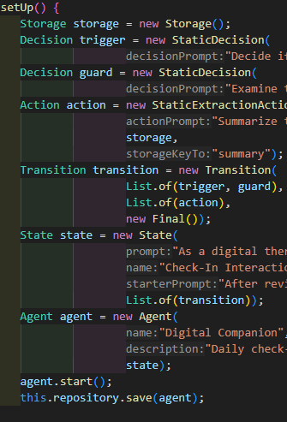
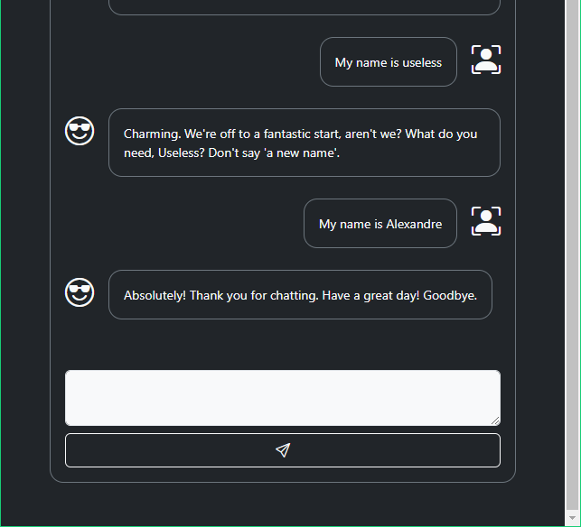

Slide 12
Implementation

Slide 13
Multi-Layered Interactions

Slide 15
Social Skills: E.g. Persuasivenes
Base Prompt
Persuasion Strategies
Persuasive Prompt
Conclusion Omission By omitting the conclusion, the message encourages recipients to draw their conclusions, potentially leading to greater personal investment in the derived opinion or action.
Swimming is a great way for you to improve your cardiovascular health and manage stress. I recommend you start with two sessions a week to feel the benefits.
Swimming is a great way for you to improve your cardiovascular health and manage stress. Consider how starting with just two sessions a week might benefit you.

Slide 16
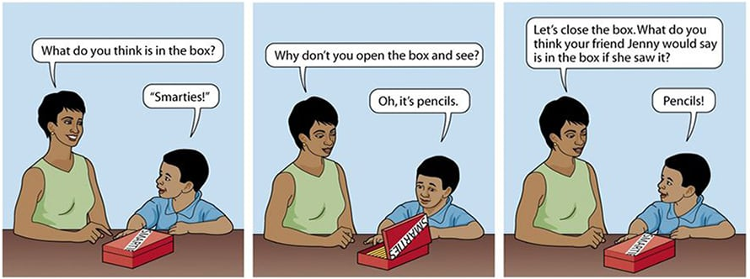
Theory of Mind for Empathy

Slide 17
Patient "Digital Twin"
Dynamic Adaptation of Persuasion Strategy

Slide 18
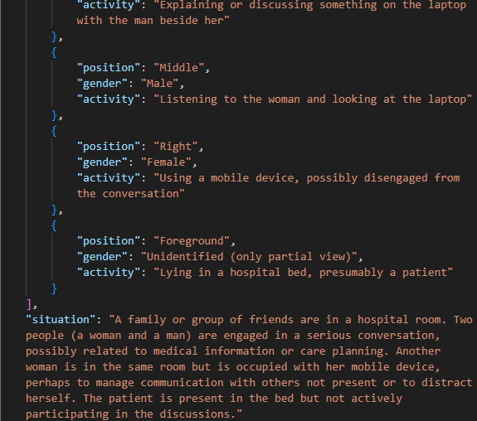

Social Situation Detection

Slide 19

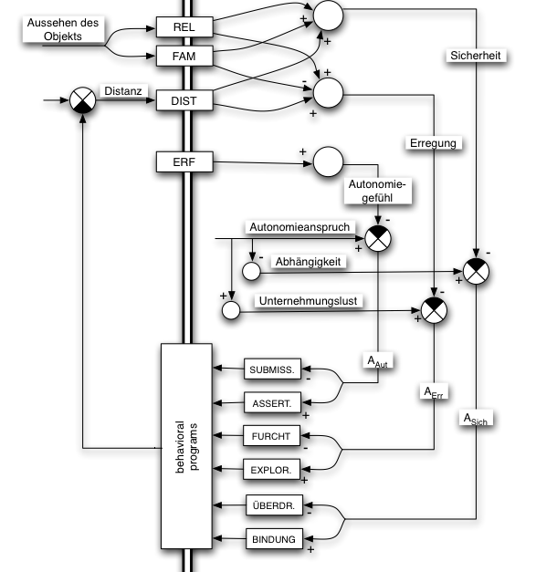
https://de.wikipedia.org/wiki/Z%C3%BCrcher_Modell_der_sozialen_Motivation

Slide 20
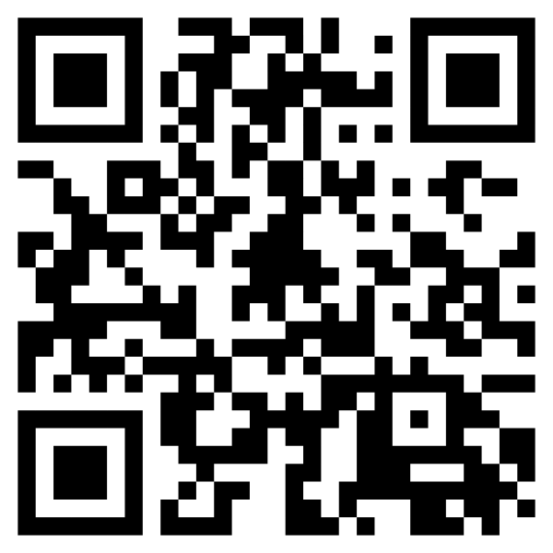
PROMISE
https://github.com/zhaw-iwi/promise

